Slide 1



Introduction to Python Programming
Python is a versatile, high-level programming language that has become increasingly popular in recent years. It is known for its clean and readable syntax, making it an excellent choice for beginners and experienced developers alike.

Slide 2

What is Python Programming?
Python programming is a powerful and versatile tool that can be used to create a wide range of applications, from simple scripts to complex software systems. Its clear syntax and extensive libraries make it a popular choice for both beginners and experienced developers.

Slide 3

Why Python?
1
General-Purpose Language
2
Easy to Learn
3
Extensive Libraries
Python's syntax is simple and easy to understand, which makes it a great choice for beginners.
Python has a wide variety of libraries and modules that can do many things, like working with data and creating visuals.
Python is versatile and can be used for many things, including web development, data analysis, machine learning, and scientific computing.

Slide 4

Python's History and Popularity
1
1991: Birth of Python
Python was created by Guido van Rossum and released as an open-source programming language.
2
2000s: Rapid Growth
Python gained widespread popularity, especially in the fields of web development, data science, and machine learning.
3
Today: Ubiquitous
Python is now one of the most widely used programming languages, with a large and active community of developers.

Slide 5
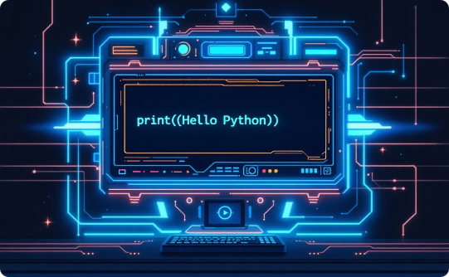


Python's Syntax and Structure
Simplicity
Indentation
Dynamic Typing
Python's syntax is designed to be clean, concise, and easy to read, with a focus on readability.
Python uses indentation to define code blocks, rather than curly braces or other delimiters.
Python is a dynamically-typed language, meaning you don't have to declare variable types explicitly.

Slide 6
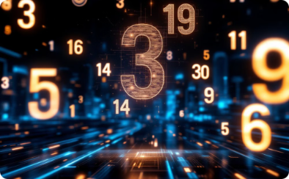
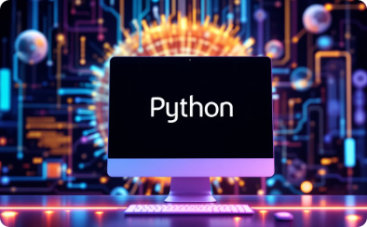

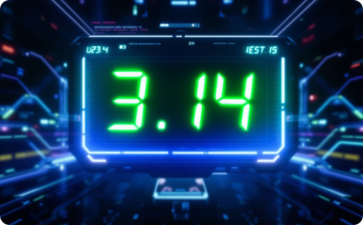
Data Types and Variables
Integer
String
Boolean
Float
Python supports integers as a built-in data type, allowing you to perform mathematical operations on whole numbers.
Strings in Python are used to represent text data and can be manipulated in various ways.
Python's boolean data type represents a logical value of either True or False.
Python also has a float data type for representing numbers with decimal points, allowing for more precise calculations.

Slide 7

Control Structures
Conditional Statements
Python provides conditional statements such as if, elif, and else, allowing you to execute different blocks of code based on specified conditions.
Loops
Python offers different types of loops, including for and while loops, that allow you to iterate over a sequence of elements or repeat a block of code until a certain condition is met.

Slide 8


Libraries and Modules
Popular Libraries
Modules
Some of the most popular Python libraries include NumPy, Pandas, Matplotlib, and TensorFlow.
Modules in Python are files that contain Python code, which can be imported and used in other Python programs.

